Slide 1
Introduction
In this course you will learn
C++
Object oriented programming

Slide 2
History of C and C++
C++ evolved from C, which evolved from two previous programming languages, BCPL and B
ANSI C established worldwide standards for C programming
C++ “spruces up” C and provides capabilities for object-oriented programming
objects - reusable software components, model things in the real world
Object-oriented programs are easy to understand, correct and modify

Slide 3
The Key Software Trend: Object Technology
Objects
reusable software components that model items in the real world
meaningful software units
date objects, time objects, paycheck objects, invoice objects, audio objects, video objects, file objects, record objects, etc.
any noun can be represented as an object
very reusable
more understandable, better organized, and easier to maintain than procedural programming
Favor modularity

Slide 4
C++ Standard Library
C++ programs consist of pieces called classes and functions
There are rich collections of existing classes and functions in the C++ standard library available for all programmers to use

Slide 5
Basics of a Typical C++ Environment
Phases of C++ Programs:
Edit
Preprocess
Compile
Link
Load
Execute
Program is created in
the editor and stored
on disk.
Editor
Disk
Preprocessor
Disk
Preprocessor program
processes the code.
Compiler
Compiler creates
object code and stores
it on disk.
Disk
Linker links the object
code with the libraries,
creates a.out and
stores it on disk
Linker
Disk
Primary
Memory
Loader
Loader puts program
in memory.
Disk
.
.
.
.
.
.
Primary
Memory
CPU
CPU takes each
instruction and
executes it, possibly
storing new data
values as the program
executes.
.
.
.
.
.
.

Slide 6
Introduction to C++ Programming
The C++ language facilitates a structured and disciplined approach to computer program design
Following are several examples that illustrate many important features of C++. Each example is analyzed one statement at a time.

Slide 7
1 // Fig. 1.2: fig01_02.cpp
2 // A first program in C++
Comments
Written between /* and */ or following a //
Improve program readability and do not cause the computer to perform any action
3 #include <iostream>
1.19 Printing a line of text
4
5 int main()
6 {
preprocessor directive
Message to the C++ preprocessor
Lines beginning with # are preprocessor directives
#include <iostream> tells the preprocessor to include the contents of the file <iostream>, which includes input/output operations (such as printing to the screen).
7 std::cout << "Welcome to C++!\n";
8
9 return 0; // indicate that program ended successfully
10 }
C++ programs contain one or more functions, exactly one of which must be main
Parenthesis used to indicate a function
int means that main "returns" an integer value. More in Chapter 3.
Welcome to C++!
Prints the string of characters contained between the quotation marks.
The entire line, including std::cout, the << operator, the string "Welcome to C++!\n" and the semicolon (;), is called a statement.
All statements must end with a semicolon.
return is one a way to exit a function.
return 0, in this case, means that the program terminated normally.

Slide 8
1.19 A Simple Program: Printing a Line of Text
std::cout
standard output stream object
“connected” to the screen
we need the std:: to specify what "namespace" cout belongs to
we shall remove this prefix with using statements
<<
stream insertion operator
value to the right of the operator (right operand) inserted into output stream (which is connected to the screen)
std::cout << " Welcome to C++!\n"
\
escape character
indicates that a “special” character is to be output

Slide 9
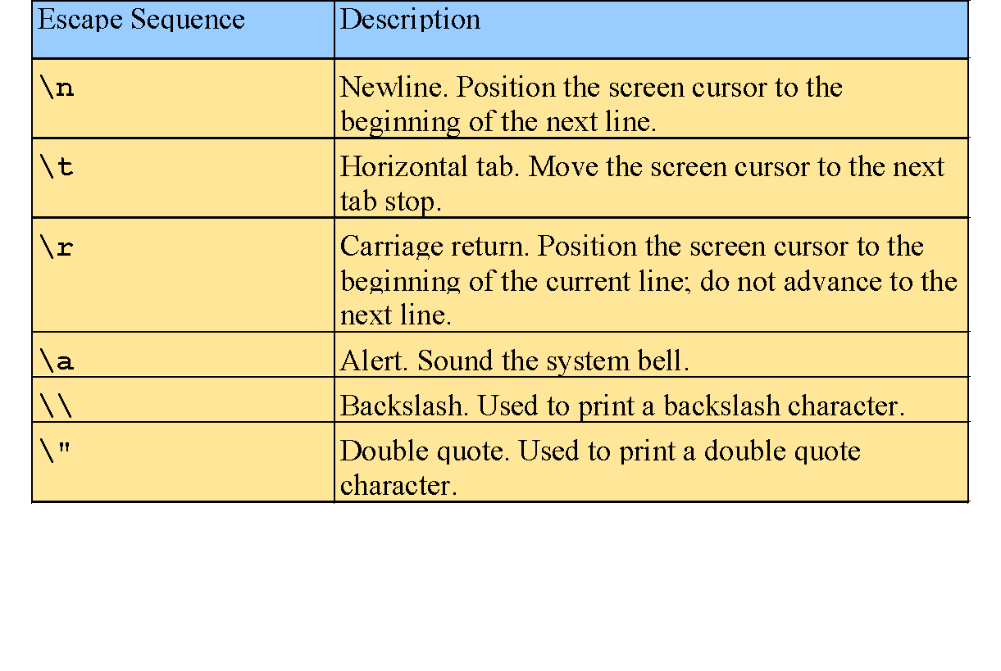
1.19 A Simple Program: Printing a Line of Text (II)
There are multiple ways to print text
Following are more examples

Slide 10
1 // Fig. 1.4: fig01_04.cpp
2 // Printing a line with multiple statements
3 #include <iostream>
1. Load <iostream>
2. main
2.1 Print "Welcome"
2.2 Print "to C++!"
2.3 newline
2.4 exit (return 0)
4
5 int main()
6 {
7 std::cout << "Welcome ";
8 std::cout << "to C++!\n";
9
10 return 0; // indicate that program ended successfully
11 }
Welcome to C++!
Unless new line '\n' is specified, the text continues on the same line.

Slide 11
1 // Fig. 1.5: fig01_05.cpp
2 // Printing multiple lines with a single statement
3 #include <iostream>
1. Load <iostream>
2. main
2.1 Print "Welcome"
2.2 newline
2.3 Print "to"
2.4 newline
2.5 newline
2.6 Print "C++!"
2.7 newline
2.8 exit (return 0)
4
5 int main()
6 {
7 std::cout << "Welcome\nto\n\nC++!\n";
8
9 return 0; // indicate that program ended successfully
10 }
Welcome
to
C++!
Multiple lines can be printed with one statement

Slide 12
Another Simple Program: Adding Two Integers
Variables
location in memory where a value can be stored for use by a program
must be declared with a name and a data type before they can be used
Must appear before variable is used
Some common data types are:
int - integer numbers
char - characters
double - floating point numbers
Example: int myVariable;
Declares a variable named myVariable of type int
Example: int variable1, variable2;
Declares two variables, each of type int

Slide 13
Another Simple Program: Adding Two Integers (II)
>> (stream extraction operator)
When used with std::cin, waits for user to input a value and stores the value in the variable to the right of the operator.
user types number, then presses the Enter (Return) key to send the data to the computer
Example:
int myVariable;
std::cin >> myVariable;
waits for user input, then stores input in myVariable
= (assignment operator )
assigns value to a variable
binary operator (has two operands)
sum = variable1 + variable2;
Addition operator

Slide 14
1 // Fig. 1.6: fig01_06.cpp
2 // Addition program
3 #include <iostream>
4
1. Load <iostream>
2. main
2.1 Initialize variables integer1, integer2, and sum
2.2 Print "Enter first integer"
2.2.1 Get input
2.3 Print "Enter second integer"
2.3.1 Get input
2.4 Add variables and put result into sum
2.5 Print "Sum is"
2.5.1 Output sum
2.6 exit (return 0)
Program Output
5 int main()
6 {
7 int integer1, integer2, sum; // declaration
8
9 std::cout << "Enter first integer\n"; // prompt
Notice how std::cin is used to get user input.
10 std::cin >> integer1; // read an integer
11 std::cout << "Enter second integer\n"; // prompt
12 std::cin >> integer2; // read an integer
13 sum = integer1 + integer2; // assignment of sum
14 std::cout << "Sum is " << sum << std::endl; // print sum
15
16 return 0; // indicate that program ended successfully
std::endl flushes the buffer and prints a newline.
17 }
Enter first integer
45
Enter second integer
72
Sum is 117
Variables can be output using std::cout << variableName

Slide 15
Memory Concepts
Variable names correspond to locations in the computer's memory.
Every variable has a name, a type, a size and a value.
Whenever a new value is placed into a variable, it replaces the previous value - it is destroyed
reading variables from memory does not change them
A visual representation
integer1
45

Slide 16
Arithmetic
Arithmetic calculations are used in most programs
special notes:
use * for multiplication and / for division
integer division truncates remainder
7 / 5 evaluates to 1
modulus operator returns the remainder
7 % 5 evaluates to 2
Operator precedence
some arithmetic operators act before others (i.e., multiplication before addition)
be sure to use parenthesis when needed
Example: Find the average of three variables a, b and c
do not use: a + b + c / 3
use: (a + b + c ) / 3

Slide 17
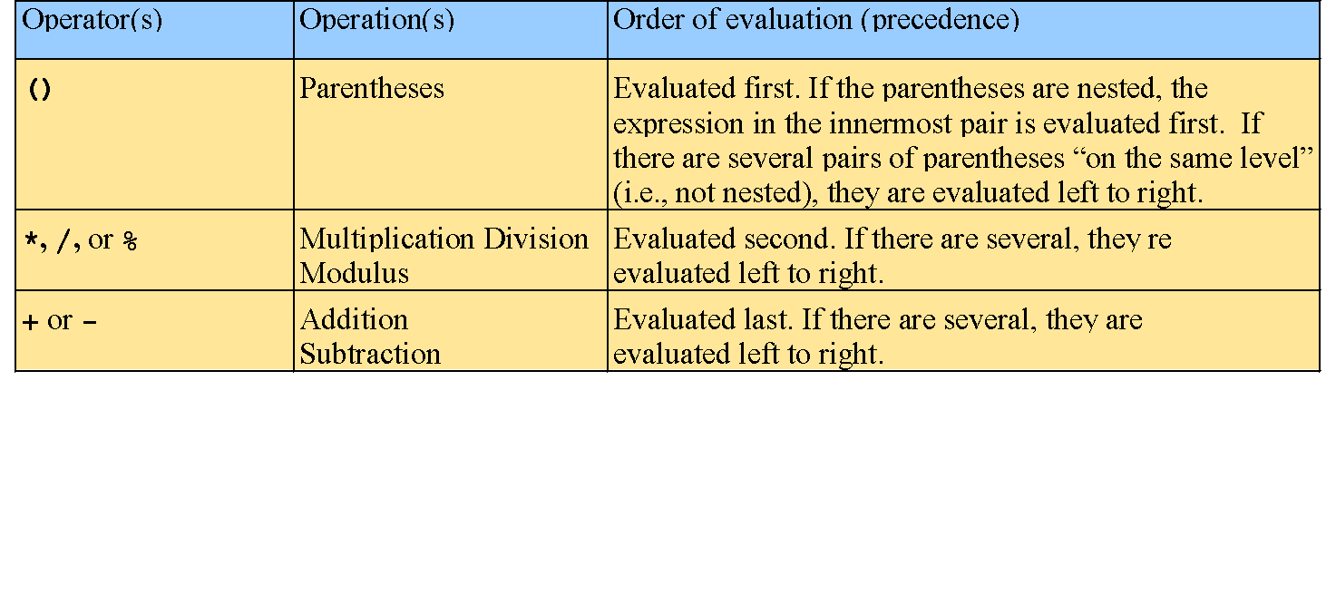
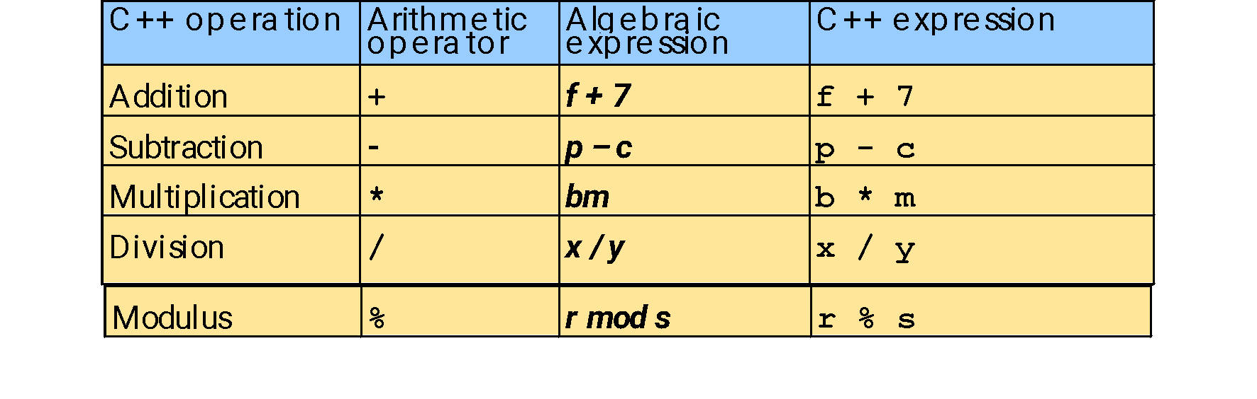
Arithmetic (II)
Arithmetic operators:
Rules of operator precedence:

Slide 18
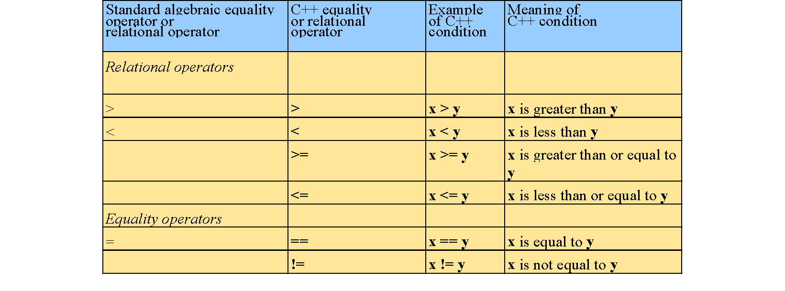
Decision Making: Equality and Relational Operators
if structure - decision based on truth or falsity of condition. If condition met execute, otherwise ignore.
Equality and relational operators:
These operators all have lower precedence than arithmetic operators
>
_
<
_
=

Slide 19
using statement
using statements
eliminate the need to use the std:: prefix
allow us to write cout instead of std::cout
at the top of the program write
using std::cout;
using std::cin;
using std::endl;
to use those functions without writing std::

Slide 20
1 // Fig. 1.14: fig01_14.cpp
2 // Using if statements, relational
3 // operators, and equality operators
4 #include <iostream>
5
1. Load <iostream>
2. main
2.1 Initialize num1 and num2
2.1.1 Input data
2.2 if statements
6 using std::cout; // program uses cout
Notice the using statements
7 using std::cin; // program uses cin
8 using std::endl; // program uses endl
9
10 int main()
11 {
12 int num1, num2;
13
14 cout << "Enter two integers, and I will tell you\n"
15 << "the relationships they satisfy: ";
16 cin >> num1 >> num2; // read two integers
Enter two integers, and I will tell you
the relationships they satisfy: 3 7
17
18 if ( num1 == num2 )
19 cout << num1 << " is equal to " << num2 << endl;
The if statements test the truth of the condition. If it is true, body of if statement is executed. If not, body is skipped.
To include multiple statements in a body, delineate them with braces {}
20
21 if ( num1 != num2 )
22 cout << num1 << " is not equal to " << num2 << endl;
3 is not equal to 7
23
24 if ( num1 < num2 )
25 cout << num1 << " is less than " << num2 << endl;
3 is less than 7
26
27 if ( num1 > num2 )
28 cout << num1 << " is greater than " << num2 << endl;
29
30 if ( num1 <= num2 )
31 cout << num1 << " is less than or equal to "
3 is less than or equal to 7
32 << num2 << endl;
33

Slide 21
34 if ( num1 >= num2 )
35 cout << num1 << " is greater than or equal to "
36 << num2 << endl;
2.3 exit (return 0)
Program Output
37
38 return 0; // indicate that program ended successfully
39 }
Enter two integers, and I will tell you
the relationships they satisfy: 3 7
3 is not equal to 7
3 is less than 7
3 is less than or equal to 7
Enter two integers, and I will tell you
the relationships they satisfy: 22 12
22 is not equal to 12
22 is greater than 12
22 is greater than or equal to 12
Enter two integers, and I will tell you
the relationships they satisfy: 7 7
7 is equal to 7
7 is less than or equal to 7
7 is greater than or equal to 7

Slide 22
Thinking About Objects: Introduction to Object Technology and the Unified Modeling Language
Object orientation
natural way to think about world and writing computer programs
Attributes - properties of objects
size, shape, color, weight, etc.
Behaviors - actions
a ball rolls, bounces, inflates and deflates
objects can perform actions as well
inheritance
new classes of objects absorb characteristics of existing classes
information hiding
objects usually do not know how other objects are implemented
Abstraction - view the big picture
See a photograph rather than a group of colored dots
Think in terms of houses, not bricks

Slide 23
Thinking About Objects: Introduction to Object Technology and the Unified Modeling Language (II)
class - unit of programming
"blueprint" of the objects
objects are created from the class
contain functions
implement behaviors
contain data
implement attributes
Classes are reusable
Unified Modeling Language (UML)
used to model object-oriented systems and aid with their design
complex, feature-rich graphical language

